Slide 1


HealthCare 101 preventive care 101
Wesleyan University, February 2020

Slide 2

Life can be busy
and complicated.
As part of your employer’s plan offered through Cigna, we give you a variety of programs and services to help make your life easier – and healthier.
Confidential, unpublished property of Cigna. Do not duplicate or distribute. Use and distribution limited solely to authorized personnel. © 2019 Cigna.

Slide 3

Agenda
Healthcare 101
  Healthcare Terms and Definitions
  Medical Plan Review
  90 day Now Program
Preventive Care 101
  Healthcare Laws
  What is preventive care?
  Understanding preventive care
    Why it’s important
    Preventive care coverage
    Questions for your doctor
  Men’s and Women’s screenings
  Flu Shots
Additional resources
Confidential, unpublished property of Cigna. Do not duplicate or distribute. Use and distribution limited solely to authorized personnel. © 2019 Cigna.

Slide 4
Healthcare 101

Slide 5

Healthcare Terms and Definitions
Network - Open Access Plus Network
A group of health care providers and facilities that your health plan contracts with to provide services at a discounted cost. They are considered “in-network”
  Providers or facilities that are not part of this group are “out-of-network”
  You typically pay less when you see in-network providers
  You have the option of choosing a primary care provider (PCP) to guide your care (it is recommended but not required)
  You can see a specialist without a referral
  Nationwide in-network coverage for emergency care
Premium/plan contribution:
The monthly or other periodic amount you pay for your health plan
Covered costs:
The charges for health care services covered by your health plan
Understanding how your health plan works can help you make the most of your plan and may even help you save money.
Confidential, unpublished property of Cigna. Do not duplicate or distribute. Use and distribution limited solely to authorized personnel. © 2019 Cigna

Slide 6
Healthcare Terms and Definitions (continued)
Copay
Your share of the costs of a healthcare service, usually figured as a percentage of the amount charged for services. You start paying coinsurance after you’ve paid your plan’s deductible. Your plan pays a certain percentage of the total bill, and you pay the remaining percentage.
Coinsurance
Your share of the costs of a healthcare service, usually figured as a percentage of the amount charged for
services. You start paying coinsurance after you’ve paid your plan’s deductible. Your plan pays a certain percentage of the total bill, and you pay the remaining percentage.
Deductible
The amount you pay for healthcare services before your health insurance begins to pay. For example,
if your plan’s deductible is $1,000, you’ll pay 100 percent of eligible healthcare expenses until the bills total $1,000 for the year. After that, you share the cost with your plan by paying coinsurance.
Out-of-pocket maximum
The most you must pay for covered services in a plan year. After you spend this amount on deductibles, copayments and coinsurance, your health plan pays 100% of the costs of covered benefits. However, you must pay for certain out-of-network charges above reasonable and customary amounts.
In-network
A group of doctors, clinics, hospitals and other healthcare providers that have an agreement with your medical plan provider. You’ll pay less when you use in-network providers.
Out-of-network
Care received from a doctor, hospital or other provider that is not part of the medical plan agreement. You’ll pay more when you use out-of-network providers.
Reasonable and customary
The amount of money a health plan determines is the normal or acceptable range of charges for a specific health related service or medical procedure. If your healthcare provider submits higher charges than what the health plan considers normal or acceptable, you may have to pay the difference.
Confidential, unpublished property of Cigna. Do not duplicate or distribute. Use and distribution limited solely to authorized personnel. © 2019 Cigna

Slide 7
Precertification
What is precertification?
  With precertification, you know in advance whether a procedure, treatment or service will be covered under your health care plan. It helps make sure that you get the right care in the right setting. It may save you from costly and unnecessary services.
Who is responsible for getting the precertification?
  › In-network services: Your doctor is responsible.
  › Out-of-network services: You’re responsible. Before you choose an out-of-network provider, make sure your plan covers out-of-network services.
    To request precertification, call the toll-free number on your Cigna ID card. When you call, make sure you have:
      › The name of the doctor or facility.
      › The procedure code(s).
      › The date of service.
Remember, with out-of-network providers your out-of-pocket costs will typically be higher. Also, your coverage may be reduced or denied if you don’t get precertification.

Slide 8
OAP Plan Highlights
Benefits | In-Network | Out-of-Network
Deductible | $500 Employee $1,000 Family | $750 Employee $1,500 Family
Out of Pocket Maximum | $1,500 Employee $3,000 Family | $2,500 Employee $5,000 Family
Preventive Care | No charge, No deductible | 30% after deductible
Office Visits | $25 PCP copay | 30% after deductible
 | $35 Specialist copay | 30% after deductible
Inpatient Facility Services | Plan pays 100%, after deductible | 30% after deductible
Outpatient Facility Services | Plan pays 100%, after deductible | 30% after deductible
Emergency Room | $200 copay per visit (copay waived if admitted)
Urgent Care | $40 copay per visit

Slide 9
OAPIN Plan Highlights
Benefits | In-Network
Deductible | $500 Employee $1,000 Family
Out of Pocket Maximum | $1,500 Employee $3,000 Family
Preventive Care | No charge, No deductible
Office Visits | $25 PCP copay $35 Specialist copay
Inpatient Facility Services | Plan pays 100%, after deductible
Outpatient Facility Services | Plan pays 100%, after deductible
Emergency Room | $200 copay per visit (copay waived if admitted)
Urgent Care | $40 copay per visit

Slide 10
HSA Plan Highlights
Benefits | In-Network | Out-of-Network
Employer Contribution | Employee: $500 Family: $500
Deductible | $1,500 Employee $3,000 Family | $1,500 Employee $3,000 Family
Out of Pocket Maximum | $3,000 Employee $6,000 Family | $3,000 Employee $6,000 Family
Preventive Care | No charge, No deductible | 20% after deductible
Office Visits | Plan pays 100%, after deductible | 20% after deductible
 | Plan pays 100%, after deductible | 20% after deductible
Inpatient Facility Services | Plan pays 100%, after deductible | 20% after deductible
Outpatient Facility Services | Plan pays 100%, after deductible | 20% after deductible
Emergency Room | Plan pays 100%, after deductible
Urgent Care | Plan pays 100%, after deductible

Slide 11

Cigna 90 Now
Making it easier to fill the medications you take every day
More choice, more convenience
Filling a 90-day supply helps make life easier
Make fewer trips to the pharmacy for refills
Less likely to miss a dose³
More likely to stay healthy³
With Cigna 90 NowSM, you can choose to fill your maintenance medications in either a 30-day or
90-day supply.
For 30-day supplies: You can use any retail pharmacy in your plan’s network. You have the option of switching to a 90-day supply at any time.
For 90-day (or three-month) supplies:¹
You can use an in-network retail pharmacy approved to fill 90-day prescriptions or home delivery.²
1. You may be taking a medication that isn’t actually available in a 90-day supply. Certain medications may only be packaged in lesser amounts. For example, three packages of a medication equal an 84-day supply. Even though it’s not a “90-day supply,” it’s still considered a 90-day prescription. 2. Some plans may not include home delivery as a covered pharmacy option. Please log in to the myCigna App or website, or check your plan materials, to learn more about the pharmacies in your plan’s network. 3. Internal Cigna analysis performed Jan 2019, utilizing 2018 Cigna National Book of Business average medication adherence (customer adherent > 80% PDC), 90-day supply vs. those who received a 30-day supply taking antidiabetics, RAS antagonists and statins.

Slide 12




Making it easier to fill the medications you take every day
You can fill:
90-day prescriptions at more than 31,000 retail pharmacies* or through home delivery**
30-day prescriptions at more than 68,000 retail pharmacies*
90-day fills
Get a 90-day prescription for your maintenance medication
Take your prescription to a 90-day
retail pharmacy in your plan’s network, or
mail to home delivery**
Get your medication. Filling your prescription four times a year in a 90-day supply means fewer visits to the pharmacy for refills.
30-day fills
Get a 30-day prescription for your maintenance medication
Take your prescription to any retail pharmacy in your plan’s network
Get your medication
*Pharmacy network as of March 2019. Subject to change. Please note that 30-day prescriptions can also be filled at 90-day in-network pharmacies.
**Some plans may not include home delivery as a covered pharmacy option. Please log in to the myCigna website or app, or check your plan materials, to learn more about the pharmacies in your plan’s network.

Slide 13

How to find a pharmacy in your network
Go to Cigna.com/Rx90network
Use the myCigna App or website
See a current list of in-network pharmacies
Learn how to move your prescription to a new pharmacy
Get answers to some frequently asked questions
Log in to the myCigna App or website
Click on “Prescriptions”
Select “Find a Pharmacy” from the dropdown menu
Enter your medication and pharmacy information
  Remember –
  You can fill 30-day prescriptions at any retail pharmacy in your plan’s network.
  You can fill 90-day prescriptions at any pharmacy with a blue “90” calendar next to it. It looks like this:
  You can fill 30-day prescriptions for short-term use (acute) medications at any retail pharmacy in your network.
  Remember –
  You can fill 30-day prescriptions at any retail pharmacy in your
  plan’s network.
  You can fill 90-day prescriptions at any pharmacy with a green
  pill bottle next to it. It looks like this:
  You can fill 30-day prescriptions for short-term use (acute) medications at any retail pharmacy in your plan’s network.

Slide 14
Preventive Care 101

Slide 15
Healthcare Reform Preventive Care Laws
The Affordable Care Act (ACA) was signed into law on March 23, 2010
For new health policies beginning on or after September 23, 2010, preventive services that have strong scientific evidence of their health benefits must be covered.
Plans cannot charge a patient a copayment, co-insurance or deductible for preventive care services when they are delivered by an in-network provider.
Office visit fees: Be aware that your plan can require you to pay some costs of the office visit, if the preventive service is not the primary purpose of the visit, or if your doctor bills you for the preventive services separately from the office visit.

Slide 16

What is Preventive Care?
Preventive care services are provided when you don’t have any symptoms and haven’t been diagnosed with a health issue connected with the preventive service.
They typically are provided during a wellness exam.
You and your doctor will determine what tests and
health screenings are right for you based on your:
Age
Gender
Personal health history
Current health
Confidential, unpublished property of Cigna. Do not duplicate or distribute. Use and distribution limited solely to authorized personnel. © 2019 Cigna.

Slide 17

Understanding Preventive Care
Even when you’re in the best shape of your life, a serious condition without any symptoms may put your health at risk. In order to get healthy and stay that way, your plan includes coverage for eligible preventive care services at no additional cost when they’re provided in-network. Covered preventive care services can include, but are not limited to:*
Screenings for blood pressure, cholesterol
and diabetes
Screening for colon/rectal cancer
Clinical breast exams and mammograms
Pap tests
* Plans may vary and not all preventive care services are covered. For example, immunizations for travel are generally not covered. See your plan materials for costs and a complete list of covered preventive care services.
Confidential, unpublished property of Cigna. Do not duplicate or distribute. Use and distribution limited solely to authorized personnel. © 2019 Cigna.
Notes:
Your health plan covers specific preventive care services. Even when you’re in the best shape of your life, a serious condition without any symptoms may but your health at risk. In order to get healthy and stay that way, your plan includes coverage for eligible preventive care services at no additional cost when they’re provided in-network. This means that no money is taken from your account and you don’t have to pay out-of-pocket costs at points of service.
These services can help prevent certain illnesses and health conditions from happening and also detect health problems at early stages, when they’re easier to treat. Examples include, but are not limited to:
Screenings for blood pressure, cholesterol, and diabetes
Screenings for colon/rectal cancer
Clinical breast exams and mammograms
Pap tests

Slide 18

Have a Conversation About Your Health Care
When your doctor determines that you have a health issue, additional screenings and test may be required. It’s important to be an educated health care consumer and talk to your doctor about whether additional screenings are diagnostic, and how they will be coded in the system.
Diagnostic screenings are not considered preventive
Diagnostic screenings may require out-of-pocket payment, but are covered by your plan’s medical benefits
Understanding how services will be coded in the system means that you can better understand how you will be billed for health care services
Confidential, unpublished property of Cigna. Do not duplicate or distribute. Use and distribution limited solely to authorized personnel. © 2019 Cigna.
Notes:
Preventive care is given to you when you're symptom free and have no reason to believe you might be unhealthy. Preventive care is often given as part of a routine physical or checkup.
Diagnostic care is what you receive when you have symptoms or risk factors and your doctor wants to diagnose them.
Example: If you go in for a routine colonoscopy and the doctor finds a polyp, the doctor should bill the preventive diagnosis as primary reason for treatment and polyp removal as secondary.
Breast Ultrasounds – 3D mammograms covered and Ultrasounds (Dense breast ultrasound) covered if coded as preventive. (Note: Because of low deductible customers didn’t realized they were being charge because it was covered at 100%). If coded as diagnostic will be covered as diagnostic and deductible will apply.
Remember to be an conscious healthcare consumer. Keep an open line of communication between you and your doctors. Don’t hesitate to ask how a procedure might be coded, or if it considered preventive.

Slide 19
Questions to Ask Your Doctor
Health Problems
What is my diagnosis?
What are my treatment options?
Where can I get more information about my condition?
What is the long-term outlook for my condition?
Medical Tests
What is the reason for this test?
How is the test done?
Are there alternatives or other options available?
How should I prepare for the test?
How often should I have these tests?
When and how will I get the results?
Medication/Pharmacy
What is the reason for this medication?
How long should I take this medication?
How often and when should it be taken?
What are side effects?
Are there any drug interactions?
Is there a generic? Can I take it?
What will happen if I don’t take the medication?
Should I avoid eating any food, drink, or activities?
Confidential, unpublished property of Cigna. Do not duplicate or distribute. Use and distribution limited solely to authorized personnel. © 2019 Cigna.

Slide 20
Men’s and Women’s Preventive Health Screenings
To help keep your one-of-a-kind self in top shape, it’s important to keep up with the following preventive screenings.
Men’s Preventive Health Screenings
Colorectal cancer
Diabetes
Prostate screening (PSA)
Blood pressure
Cholesterol
Healthy Weight
Women’s Preventive Health Screenings
Breast cancer
Cervical cancer
Blood pressure
Chlamydia
Colorectal cancer
Diabetes
Osteoporosis (bone density)
Confidential, unpublished property of Cigna. Do not duplicate or distribute. Use and distribution limited solely to authorized personnel. © 2019 Cigna.
Notes:
Mens
Colorectal Cancer: If you’re 50 or older, getting a screening test for colorectal cancer could save your life. If you have a family history of colorectal cancer, you may need to be screened earlier. Talk with your doctor to decide which type of test is best for you.
Diabetes: Get tested if you’re at risk for diabetes. Talk with your doctor about your risk factors.
Prostate Screening (PSA): Men age 50 and older or age 40 with risk factors, should have a PSA blood test. Discuss the frequency of the testing with your doctor.
Blood pressure: Have your blood pressure checked during your preventive health visit. Depending on the results, your doctor will advise you on the frequency of your screening. Uncontrolled high blood pressure can increase your risk of having a heart attack and stroke.
Cholesterol: High cholesterol is a serious risk factor for coronary artery disease, heart attack and stroke. Have your cholesterol checked, starting at age 35 or older, or age 20 – 35 if risk factors for heart disease are present.
Healthy Weight: Body Mass Index (BMI) is calculated using your weight and height. Check your BMI annually to identify weight concerns that may lead to health problems.
Women’s
To help keep your one-of-a-kind self in top shape, it’s important to keep up with the preventive screenings for the following.
Breast Cancer: If you are a woman age 40 or older, talk with your doctor about when to begin having mammograms and how often to have the screening done.
Cervical Cancer: A Pap test is the best way to detect early signs of cervical cancer when the disease is highly curable and treatment is most effective If you’re age 30 and older, ask your doctor about human papillomavirus (HPV) which is a virus that can cause precancerous cell changes.
Blood pressure: Have your blood pressure checked during your preventive health visit. Depending on the results, your doctor will advise you on the frequency of your screening. Uncontrolled high blood pressure can increase your risk of having a heart attack and stroke.
Chlamydia: Symptoms are usually mild or absent, and serious complications can cause irreversible damage, including infertility. All sexually active women age 24 and younger and women 25 and older with certain risk factors, should be screened.
Colorectal cancer: If you’re age 50 or older, getting a screening test for colorectal cancer could save your life. If you have a family history of colorectal cancer, you may need to be screened earlier. Talk with your doctor to decide which type of test is best for you.
Diabetes: Get tested if you’re at risk for diabetes. Talk with your doctor about your risk factors.
Osteoporosis (bone density): If you are 65 or older, or younger with certain risk factors,
your doctor may order this screening.

Slide 21

Flu vaccinations*
Help protect yourself against the flu. One of the best ways to avoid catching the flu is to get vaccinated. Germs spread fast, especially around the workplace. So help protect yourself and others by getting a flu shot.
* Flu shot clinics are independently administered by third-party providers and not by Cigna. Always speak to your doctor about appropriate treatment, testing, and care recommendations.
Confidential, unpublished property of Cigna. Do not duplicate or distribute. Use and distribution limited solely to authorized personnel. © 2019 Cigna.

Slide 22
Medical Vaccine Program
Vaccinations can be administered at participating pharmacies at no additional cost.
* The list above is not comprehensive. If you do not see the retailer of your choice on this list, please call Cigna at
1-800-244-6224 for more information.
Albertson’s Pharmacy | Giant Eagle | Osco Drug & Pharmacy | Stop and Shop Pharmacy
Big Y Food Stores | Hannaford Food & Drug | Pharmacy Express | TOPs Markets
Costco Pharmacy | Hen House | Price Chop Pharmacy | United Supermarkets
CVS Pharmacy | Kroger | Publix | Walgreens
Drug Warehouse | Longs | Ralphs | Wal-Mart
Duane Reade | Medx | Rite Aid | Wegmans
Farm Fresh | Metro Market Pharmacy | Roundy’s Supermarket | Winn-Dixie
Confidential, unpublished property of Cigna. Do not duplicate or distribute. Use and distribution limited solely to authorized personnel. © 2019 Cigna.

Slide 23

Additional Tools and Resources
Confidential, unpublished property of Cigna. Do not duplicate or distribute. Use and distribution limited solely to authorized personnel. © 2019 Cigna.

Slide 24
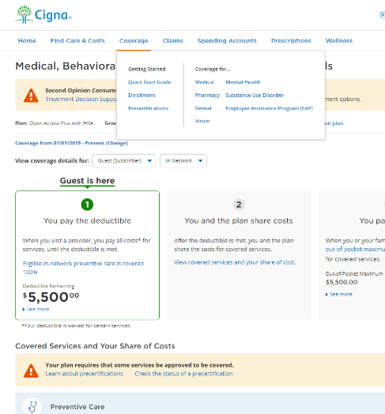
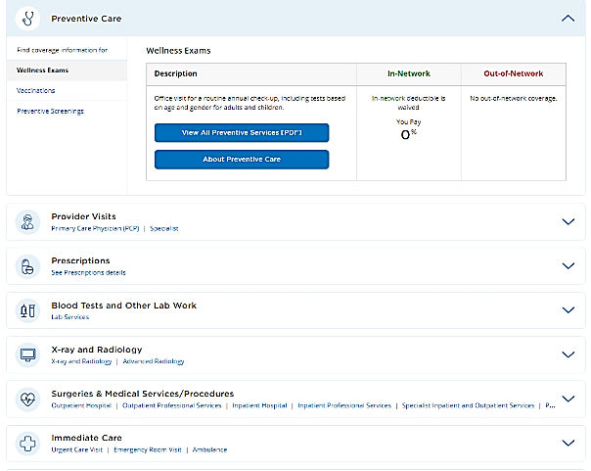
myCigna.com Preventive Care
Confidential, unpublished property of Cigna. Do not duplicate or distribute. Use and distribution limited solely to authorized personnel. © 2019 Cigna.

Slide 25
myCigna.com
Your online home for assessment tools, plan management, medical updates, and more.
Find in-network doctors, dentists, and medical services
View ID card information
Review coverage
Manage and track claims, account balances, and deductibles
Compare provider cost and quality information
Assess health and wellness tools and resources
Sign up to receive alerts when documents are available
Download the myCigna® App and access your account with just a fingerprint on any compatible device.*
*Prices are not guaranteed, and even though a price is displayed in the Drug Cost tool, it’s not a guarantee of coverage. Your costs and coverage may change by the time you fill your prescription at the pharmacy, and medication costs at individual pharmacies can vary. For example, your pharmacy’s retail cash price for a specific medication may be less than the price shown in the Drug Cost tool. Coverage and pricing may change. **Please refer to your phone’s manufacturer for your phone’s specific capabilities. The downloading and use of the myCigna app is subject to the terms and conditions of the App and the online stores from which it is downloaded. Standard mobile phone carrier and data usage charges apply. Actual myCigna features may vary depending on your plan and individual security profile.
Confidential, unpublished property of Cigna. Do not duplicate or distribute. Use and distribution limited solely to authorized personnel. © 2019 Cigna.
Notes:
Nothing is more important than your good health.
That’s why there’s myCigna – your online home for assessment tools, plan management, medical updates and much more. On myCigna you can:
Find in-network doctors, dentists and medical services
View ID card information
Review your coverage
Manage and track claims
Order refills or talk with a pharmacist at Cigna Home Delivery PharmacySM
Use our Prescription Drug Price Quote tool to compare real-time drug pricing specific to your plan
Take your health assessment
Compare cost and quality information for doctors and hospitals
Access a variety of health and wellness tools and resources (Optional note: such as online programs that give you the convenience and flexibility of working on goals on your own time and in your own terms. Example goals include eating better, enjoying exercise and feeling happier.)
Sign up to receive alerts when new plan documents are available
Track your account balances and deductible
You can also access myCigna on the go by downloading the myCigna App.*

Slide 26
24/7 customer assistance
A phone call away
Anytime you need us, feel free to call the toll-free number printed on the back of your Cigna ID card.
You can reach us
24 hours a day, seven days a week
You can get
answers to your health, claims and benefit questions
Ask for a Spanish-speaking service representative, or someone who can translate one of
200 languages
You can order an ID card, update insurance information and check claim status
Confidential, unpublished property of Cigna. Do not duplicate or distribute. Use and distribution limited solely to authorized personnel. © 2019 Cigna.
Notes:
Whenever you need us, just call the toll-free number printed on the back of your Cigna ID card for customer assistance 24 hours a day, seven days a week, 365 days a year.
24/7 customer assistance does not apply to voluntary products.

Slide 27

Alternate Care Options
Confidential, unpublished property of Cigna. Do not duplicate or distribute. Use and distribution limited solely to authorized personnel. © 2019 Cigna.

Slide 28
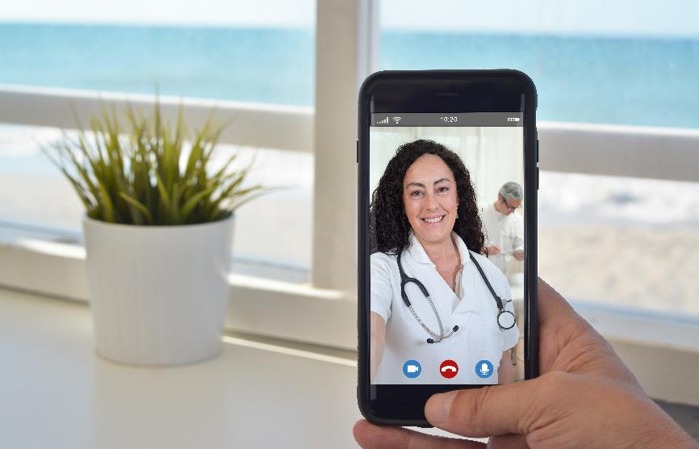
Virtual Care – Telehealth
Cigna Virtual Care lets you get the care you need – including most prescriptions (when appropriate) – for a wide range of minor conditions.
Connect with a board-certified provider via phone
or video chat, when, where and how it works best
for you.
When: 24/7/365 day or night, including weekends
and holidays.
How: Phone or video chat.
Telehealth services are provided exclusively by third-party vendors and not by Cigna. Providers are solely responsible for any treatment provided. Not all providers have video chat capabilities. Video chat is not available in all areas. These services are separate from the health plan’s provider network. Telehealth services may not be available in all areas or under all plan types. A primary care provider referral is not required for telehealth services. In general, to be covered by your plan, services must be medically necessary and used for the diagnosis or treatment of a covered condition. Cigna does not guarantee that a prescription will be written. See your plan materials for costs and details of coverage, including a complete description of telehealth/telemedicine benefits that may be available under your employer's specific health plan.
Confidential, unpublished property of Cigna. Do not duplicate or distribute. Use and distribution limited solely to authorized personnel. © 2019 Cigna.
Notes:
Cigna partners with two vendors for virtual care: Amwell and MDLive®. Amwell is medical-only, while MDLIVE is now medical and behavioral.
Employees can schedule appointments by phone via each vendor’s phone number or online via single sign-on access through myCigna.com and myCigna App
In addition to MDLIVE Behavioral, employees still have access to video-based counseling through the Cigna Behavioral Health network. They search the directory on myCigna.com, entering “Virtual counselor” under doctor by type and call the number on their Cigna ID card 24/7 to make an appointment.
Nothing is more important than your good health.
That’s why there’s myCigna – your online home for assessment tools, plan management, medical updates and much more. On myCigna you can:
Find in-network doctors, dentists and medical services
View ID card information
Review your coverage
Manage and track claims
Order refills or talk with a pharmacist at Cigna Home Delivery PharmacySM
Use our Prescription Drug Price Quote tool to compare real-time drug pricing specific to your plan
Take your health assessment
Compare cost and quality information for doctors and hospitals
Access a variety of health and wellness tools and resources (Optional note: such as online programs that give you the convenience and flexibility of working on goals on your own time and in your own terms. Example goals include eating better, enjoying exercise and feeling happier.)
Sign up to receive alerts when new plan documents are available
Track your account balances and deductible
You can also access myCigna on the go by downloading the myCigna App.*

Slide 29
Health Information Line
Call the Health Information Line 24 hours a day, seven days a week. Speak with a clinician trained as a nurse who is ready to provide medical guidance and help answer health questions like how to treat a twisted ankle or a child's fever. This toll-free number is printed on the back of your Cigna ID card.
Get information to help you decide where and when you should get treatment for immediate health care needs.
Call if you need general health information or have a specific health concern.
You can also listen to hundreds of podcasts to help you stay informed about your health.
Select a topic and listen via live-stream on your computer via myCigna.com.
Confidential, unpublished property of Cigna. Do not duplicate or distribute. Use and distribution limited solely to authorized personnel. © 2019 Cigna.
Notes:
Call the 24-hour Health Information Line (24 hours a day, seven days a week) to speak with a nurse who is ready to provide information and help answer your health questions. This toll-free number is printed on the back of your Cigna ID card.
Get information to help you decide where and when you should get treatment.
Need general health information or have a specific health concern.
You can also listen to hundreds of podcasts to help you stay informed about your health.
Select a topic and download podcasts to your mobile device* or listen via live-stream on your computer via myCigna.com.

Slide 30

Cigna Healthy Rewards® Program*
Get discounts on the health products and programs you use every day, for:
Fitness & Mind/Body
$25 Fitness clubs membership through Active and Fit Direct
Weight management and Nutrition
Vision and Hearing Care
Alternative Medicine
Health and Wellness Products
Discounts can be found on myCigna.com > Wellness > Health Rewards Discount Program
Some Healthy Rewards programs are not available in all states and programs may be discontinued at any time. If your plan includes coverage for any of these services, this program is in addition to, not instead of, your plan benefits. A discount program is NOT insurance and you must pay the entire discounted charge.
Confidential, unpublished property of Cigna. Do not duplicate or distribute. Use and distribution limited solely to authorized personnel. © 2019 Cigna.
Notes:
Just use your Cigna ID card when you pay and let the savings begin.

Slide 31

WANT TO LEARN MORE?
800.244.6224 | myCigna.com
Confidential, unpublished property of Cigna. Do not duplicate or distribute. Use and distribution limited solely to authorized personnel. © 2019 Cigna.

Slide 32
This is general health information and not medical advice or services. Always consult your doctor for appropriate examinations, treatment, testing and health care recommendations.
Product availability may vary by location and plan type and is subject to change. All group health benefit plans and health insurance policies contain exclusions and limitations. For costs and complete details of coverage, see your plan documents or contact your Cigna representative.
All Cigna products and services are provided exclusively by or through operating subsidiaries of Cigna Corporation, including Cigna Health and Life Insurance Company (CHLIC), Connecticut General Life Insurance Company, Cigna Behavioral Health, Inc., Cigna Health Management, Inc., Cigna Onsite Health, LLC, Tel-Drug, Inc., Tel-Drug of Pennsylvania, L.L.C., and HMO or service company subsidiaries of Cigna Health Corporation, including Cigna HealthCare of Arizona, Inc., Cigna HealthCare of California, Inc., Cigna HealthCare of Colorado, Inc., Cigna HealthCare of Connecticut, Inc., Cigna HealthCare of Florida, Inc., Cigna HealthCare of Georgia, Inc., Cigna HealthCare of Illinois, Inc., Cigna HealthCare of Indiana, Inc., Cigna HealthCare of St. Louis, Inc., Cigna HealthCare of North Carolina, Inc., Cigna HealthCare of New Jersey, Inc., Cigna HealthCare of South Carolina, Inc., Cigna HealthCare of Tennessee, Inc. (CHC-TN), and Cigna HealthCare of Texas, Inc. “Cigna Home Delivery Pharmacy” refers to Tel-Drug, Inc. and Tel-Drug of Pennsylvania, L.L.C. Policy forms: OK - HP-APP-1 et al. OR - HP-POL38 02-13, TN - HP-POL43/HC-CER1V1 et al. (CHLIC); GSA-COVER, et al. (CHC-TN). The Cigna name, logo, and other Cigna marks are owned by Cigna Intellectual Property, Inc. All pictures are used for illustrative purposes only.
929657 06/19 © 2019 Cigna. Some content provided under license.
Confidential, unpublished property of Cigna. Do not duplicate or distribute. Use and distribution limited solely to authorized personnel. © 2019 Cigna.

